Slide 1

DATABASE COURSE 2023/2024
SESSION 5

Slide 2
SESSION 5
DATA ORDERING
UNIQUE RECORDS
FILTERING CLAUSES

Slide 3
DATA ORDERING
ORDER BY Syntax
MySQL/Oracle
SELECT field1, field2, field3 FROM table WHERE field1 = ValueField1 ORDER BY field1 ASC;
SELECT field1, field2, field3 FROM table WHERE field1 = ValueField1 ORDER BY NumberOfField DESC;
NOTE: By default it performs ASCENDING sorting
Notes:
El campo por el que se ordena siempre debe estar entre los seleccionados

Slide 4
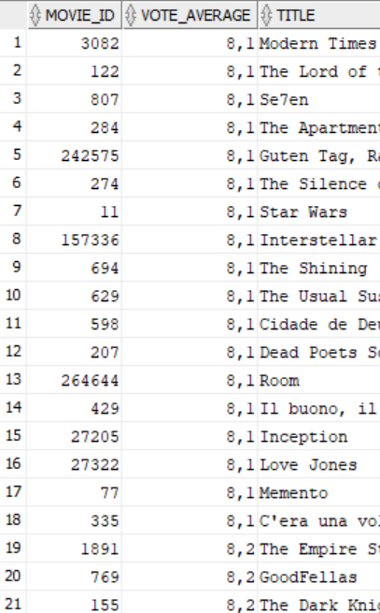
DATA ORDERING
ORDER BY Example
BBDD/User: moviebig
MySQL/Oracle
SELECT movie_id, vote_average, title
FROM moviebig
WHERE vote_average > 8
ORDER BY vote_average ASC;
SELECT movie_id, vote_average, title
FROM moviebig
WHERE vote_average > 8
ORDER BY 2 ASC;

Slide 5
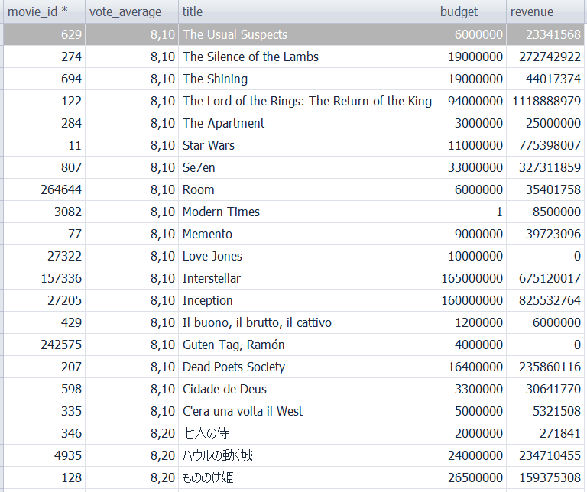
DATA ORDERING
ORDER BY Example
BBDD/User: moviebig
MySQL/Oracle
SELECT movie_id, vote_average, title, budget, revenue
FROM moviebig
WHERE vote_average > 8
ORDER BY vote_average ASC,title DESC;
SELECT movie_id, vote_average, title, budget, revenue
FROM moviebig
WHERE vote_average > 8
ORDER BY 2 ASC,3 DESC;
Notes:
Mysql considers numbers before letters
Oracle considers letter before numbers

Slide 6
SESSION 5
DATA ORDERING
UNIQUE RECORDS
FILTERING CLAUSES

Slide 7
UNIQUE RECORDS
DISTINCT Syntax
MySQL/Oracle
SELECT DISTINCT Field1, Field2
FROM table
WHERE Field1 = Value1
AND ...

Slide 8
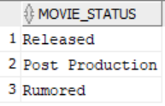
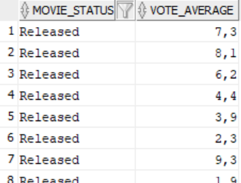
UNIQUE RECORDS
DISTINCT Example
BBDD/User: moviebig
MySQL/Oracle
SELECT DISTINCT movie_status
FROM moviebig;
MySQL/Oracle
SELECT DISTINCT movie_status, vote_average
FROM moviebig;

Slide 9
SESSION 5
DATA ORDERING
UNIQUE RECORDS
FILTERING CLAUSES

Slide 10
FILTERING CLAUSES
BETWEEN Syntax
MySQL/Oracle
SELECT field1, field2 FROM table WHERE field1 BETWEEN RangeStart AND RangeEnd AND field2 = Field2Value

Slide 11
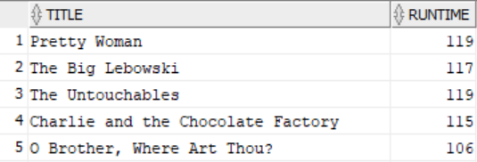
FILTERING CLAUSES
BETWEEN Example
BBDD/User: moviebig
MySQL/Oracle
SELECT title, runtime
FROM moviebig
WHERE runtime BETWEEN 100 AND 120;

Slide 12
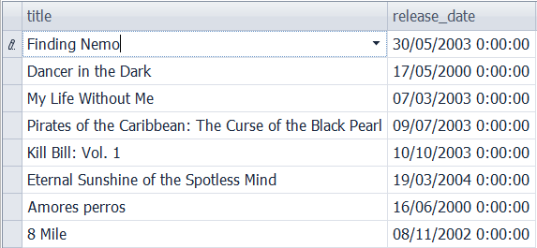
FILTERING CLAUSES
BETWEEN Example
BBDD/User: moviebig
MySQL
SELECT title, release_date
FROM moviebig
WHERE release_date BETWEEN '2000-01-01' AND '2004-12-31';
Oracle
SELECT title, release_date
FROM moviebig
WHERE release_date BETWEEN '01-01-2000' AND '31-12-2004';

Slide 13
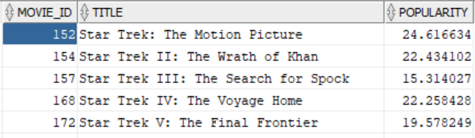
FILTERING CLAUSES
NOT Syntax
MySQL/Oracle
SELECT field1, field2 FROM table WHERE NOT field1 = Field1Value AND NOT field2 = Field2Value
NOT Examples
BBDD/User: moviebig
MySQL/Oracle
SELECT movie_id, title,
popularity
FROM moviebig
WHERE NOT popularity > 25;

Slide 14
FILTERING CLAUSES
IN/NOT IN Syntax
MySQL/Oracle
SELECT *
FROM table
WHERE Field1 IN (Value1, Value2,..., ValueN)
SELECT *
FROM table
WHERE Field1 NOT IN (Value1, Value2,..., ValueN)

Slide 15
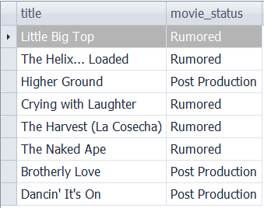
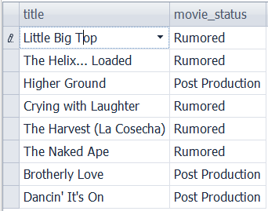
FILTERING CLAUSES
IN/NOT IN Example
BBDD/User: moviebig
MySQL/Oracle
SELECT title, movie_status
FROM moviebig
WHERE movie_status
IN ('Post Production','Rumored');
MySQL/Oracle
SELECT title, movie_status
FROM moviebig
WHERE movie_status
NOT IN ('Released');

